Slide 1
Cloud Computing
Textbook:
– RajKumar Buyya

Slide 2
In 1969, Leonard Kleinrock , one of the chief scientists of the original ARPANET said:
“As of now computer networks are still in their infancy, but as they grow up and become sophisticated, we will probably see the spread of “ Computer Utilities” which , like present electric and telephone utilities will service individual homes and offices across the country.”
This vision of computing utilities based on a service provisioning model transformed the entire computing industry in the 21st century .

Slide 3




















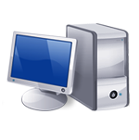






I need to grow my infrastructure, but I do not know for how long…
I have a lot of infrastructure that I want to rent …
I have a surplus of infrastructure that I want to make use of
I cannot invest in infrastructure, I just started my business….
I have infrastructure and middleware and I can host applications
I want to focus on application logic and not maintenance and scalability issues
Global Cloud Marketplace
I have infrastructure and provide application services
I want to access and edit my documents and photos from everywhere..

Slide 4
Defining a Cloud
Cloud computing became a popular buzzword and it has been widely used to refer to different technologies, services and concepts.
It is often associated with
Virtualized infrastructure
Hardware on demand
Utility computing
IT Outsourcing
Platform and software as a service

Slide 5
The term “ cloud” has historically been used in the telecommunication industry for networks.
Later became popular symbol for Internet.
It also referred to the Cloud Computing- refers to an Internet- Centric way of doing computing.
“Cloud computing refers to both the applications delivered as services over the Internet, and the hardware and system software in the datacenters that provide those services.”
Armburst

Slide 6
Everything as a service- XaaS²
Where the different components of a system can be delivered , measured and consequently priced as service.
Definition proposed by American National Institute of Standards and Technology (NIST)
“Cloud Computing is a model for enabling ubiquitous , convenient, on-demand network access to a shared pool of configurable computing resources ( e.g.: networks, servers, storage, applications and services) that can be rapidly provisioned and released with minimal management effort or service provider interaction”

Slide 7
Cloud Computing referred to “Utility-Oriented approach.”
It uses “Pay-Per-Use Strategy”.
All the operations -to access online storage, to rent virtualized hardware or to use development platforms pay only for their effective usage by entering the card details.

Slide 8
According to Reese, we can define three criteria to discriminate whether a service is delivered in the Cloud Computing style:
The service is accessible via a web browser or Web Services API.
Zero Capital expenditure is necessary to get started.
You pay only for what you use as you use it.
Users subscribe to the service and establish with the service provider a Service Level Agreement ( SLA) defining quality of service parameters under which the service is delivered.

Slide 9
Cloud Computing is helping enterprises, governments, public and private institutions, as well as research organizations shape more effective and demand- driven computing systems.
Examples:
Large Enterprises can offload some of their activities to cloud based system ( New York Times)
Small enterprises and start- ups can afford to translate into business results their ideas more quickly without excessive upfront costs. ( Animoto)
System developers can concentrate on the business logic rather than dealing with eh complexity of infrastructure management and scalability ( Little Fluffy Toys- widget about rental bicycle services)

Slide 10
End-users can have their documents accessible from everywhere and any device. (Apple iCloud)
Three major models for deployment and accessibility :
Public cloud : Established by 3rd party developers available to any consumer
Private Cloud : In- house Models, need to keep confidential information within organization premises.
Hybrid Cloud : Composed by public cloud and private owned infrastructures, created to serve the organization needs.

Slide 11
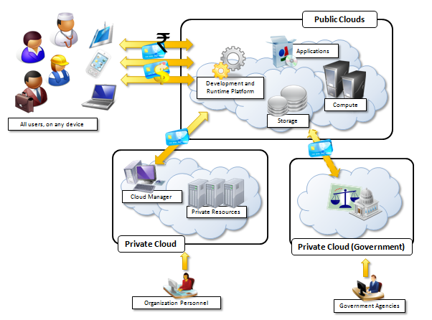

Slide 12












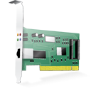
Cloud- Computing Reference Model
Web 2.0 Interfaces
Software as a Service
End user applications
Scientific applications
Office automation, Photo editing,
CRM, and Social Networking
Examples: Google Documents, Facebook, Flickr
Platform as a Service
Runtime Environment for Applications
Development and Data Processing Platforms
Examples: Windows Azure, Hadoop, Google AppEngine, Aneka
Infrastructure as a Service
Virtualized Servers
Storage and Networking
Examples: Amazon EC2, S3, Rightscale, vCloud

Slide 13
Characteristics and Benefits
Characteristics: Interesting characteristics that bring benefits to both Cloud Service Consumers (CSCs) and Cloud Service Providers (CSPs). They are:
No upfront commitments
On demand access
Nice pricing
Simplified application acceleration and scalability
Efficient resource allocation
Energy efficiency and
Seamless creation and the use of third- party services.

Slide 14
Increased economical return due to reduced maintenance and operational costs related to IT software and infrastructure.
Increased agility, users can more dynamically and flexibly compose their software systems.
Availability of data anywhere, at any time and through multiple devices.
Multi- tenancy allows for a better utilization of the shared infrastructure .
Service orientation and on-demand access create new opportunities for composing system and applications with a flexibility and in no time.

Slide 15
Challenges Ahead
Configuration, Networking and sizing of Cloud computing systems based on demand provisioning.
Iaas:
How many resources?
How long in order to maximize benefits?
Technical challenges for providers like:
Management of large Infrastructure
Use of virtualization technologies
Security and legislation

Slide 16
Security :
Confidentiality
Secrecy
Protection of data
Legal issues:
Different legislations different countries
American legislation – Government agencies can acquire confidential data , if it suspects.
European Countries- More restrictive and protect the right of privacy.

Slide 17
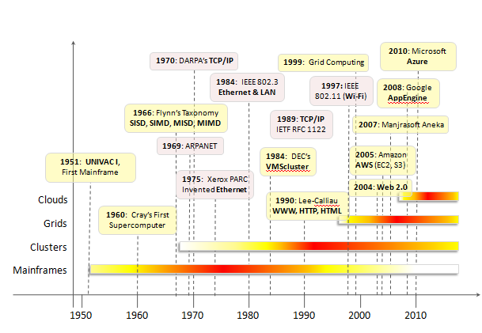
Historical Developments

Slide 18
Five core technologies that played an important role in realizing the importance of Cloud Computing.
Distributed Systems
Virtualization
Web 2.0
Service- Oriented Computing
Utility computing

Slide 19
Distributed Systems
“A distributed system is a collection of independent computers that appears to its users as a single coherent systems.”- Tanenbaum.
Properties of DS:
Heterogeneity
Openness
Scalability
Transparency
Concurrency
Continuous availability
Independent failures

Slide 20
Three major milestones that led to CC:
Mainframe Computing
Cluster Computing
Grid Computing
Mainframe: Powerful, Highly reliable computers for large data movement and massive IO operations.
Used by large organizations- Online transactions, enterprise resource planning (ERP)
Not considered as Distributed systems
“always on”- No shut down required to replace a failed component.
Evolved versions are being used now- Online banking, airplane ticketing, Super market, govt. services

Slide 21
Cluster
Low –cost alternative to mainframe.
Connected by high-bandwidth network and controlled by specific software tools
Perform more computational work in less cost.
Easily extended if more computation required.
This technology considerably contributed to the evolution of tools and framework for distributed computing .
Condor, Parallel Virtual Machine (PVM) and Message Passing Interface (MPI).

Slide 22
Grids
Considered as an evolution of cluster computing.
It proposed a new approach to access large computational power, huge storage facilities and a variety of services.
Different from cluster , it is a dynamic aggregation of heterogeneous computing nodes and its scale was nationwide or even worldwide.

Slide 23
Virtualization
Around for more than 40 years.
Example : Hardware virtualization- allows the co-existence of different software stacks on top of the same hardware.
Present inside the virtual Machine Instances, which operates completely isolated from each other.
Base technology that enables the CC.
Isolation and customization makes this technology attractive.

Slide 24
Web 2.0
At present, the Web encompasses a set of technologies and services that facilitate interactive information sharing, collaboration, user-centered design, and application composition.
This evolution has transformed the Web into a rich platform for application development and is known as Web 2.0

Slide 25
Web 2.0 brings interactivity and flexibility into Web pages.
Technologies: XML, Asynchronous JavaScript and XML (AJAX), Web Services.
Accessed from a variety of devices.
Web 2.0 applications are
extremely dynamic
they improve continuously
new updates and features are integrated at a constant rate by following the usage trend of the community.
Lightweight deployment and programming models are very important for effective support of such dynamism

Slide 26
Examples:
Google Documents
Google Maps,
Flickr,
Facebook,
Twitter,
YouTube,
Blogger, and
Wikipedia.
In particular, social networking Websites
AJAX and Really Simple Syndication (RSS)- powerful tools

Slide 27
Service- Oriented Computing
Core reference model for cloud computing systems.
SOC supports the development of rapid, low-cost, flexible, interoperable, and evolvable applications and systems.
Virtually any piece of code that performs a task can be turned into a service.
A service is supposed to be loosely coupled, reusable, programming language independent, and location transparent.

Slide 28
Loose coupling allows services to serve different scenarios more easily and makes them reusable.
Independence from a specific platform increases services accessibility.
Service-oriented computing introduces and diffuses two important concepts: quality of service (QoS) and Software-as-a-Service (SaaS).
Quality of service (QoS) identifies a set of functional and non-functional attributes that can be used to evaluate the behaviour of a service from different perspectives.
The term has been inherited from the world of application service providers (ASPs)

Slide 29
Utility-oriented computing
It defines a service-provisioning model for compute services in which resources such as storage, compute power, applications, and infrastructure are packaged and offered on a pay-per-use basis.
E-commerce technologies provided the infrastructure support for utility computing.
From an application and system development perspective, service-oriented computing and service-oriented architectures (SOAs) introduced the idea of leveraging external services for performing a specific task within a software system.

Slide 30
Computing Platforms and Technologies
Amazon Web Services (AWS)
It offers Cloud IaaS services.
It is mostly known for its compute and storage on demand services, namely EC2 and S3.
Elastic Compute Cloud (EC2) and Simple Storage Service ( S3)
S3:
Users can store objects of any size, from simple files to entire disk images and have them accessible from everywhere.
EC2:
It provides customizable virtual hardware including GPU and cluster instances.

Slide 31
Google AppEngine
Devoted to executing Web applications.
Provides both a secure execution environment and a simplified development of scalable and high performance web applications.
Languages: Python, Java and Go
Services:
In-memory
Caching
Scalable data store
Job queues
Messaging
Cron tasks.

Slide 32
Microsoft Azure
Cloud Operating System and a platform for developing apps in the cloud.
Organized around concept of roles.
Other services: Networking, storage, caching, content delivery and other
Types of roles:
Web role : To host a web app
Worker role: Generic container perform workload processing.
Virtual machine role: Virtual Environment, can customize OS

Slide 33
Hadoop
Open source framework
Process large data sets on commodity hardware.
Implementation of MapReduce- operations of data processing (Developed-Google)
Sponsor – Yahoo!
Yahoo! Manages the largest Hadoop cluster in the world, which is also available to academic institutions.

Slide 34
Force.com and Salesforce.com
Force.com- developing social enterprise apps.
Salesforce.com- SaaS- Customer relationship Management.
Allows ready-to-use blocks
Complete support for app development
Design of data layout
Def of business rules and workflows
Def of user interface

Slide 35
Manjrasoft Aneka
Provides rapid creation of scalable apps and their deployment on various types of clouds in a seamless and elastic manner.
Supports a collection of programming abstractions for developing apps and a distributed runtime environment that can be deployed on heterogenous hardware.
Different abstractions: task, distributed threads and map-reduce.
Example for three services IaaS, PaaS, SaaS.

